Slide 1
Linear correlation and linear regression

Slide 2
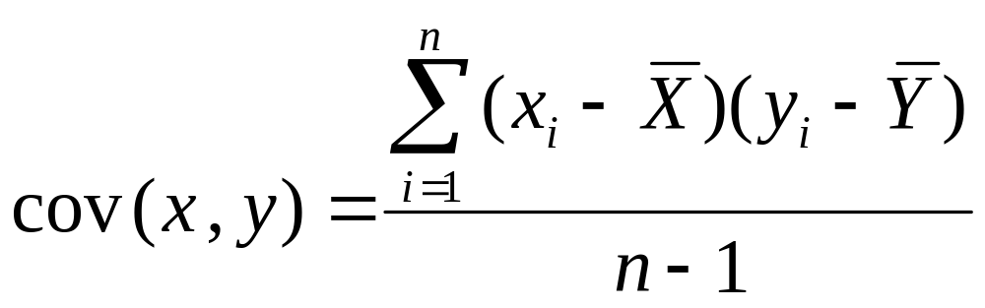
Recall: Covariance

Slide 3
Interpreting Covariance
cov(X,Y) > 0 X and Y are positively correlated
cov(X,Y) < 0 X and Y are inversely correlated
cov(X,Y) = 0 X and Y are independent

Slide 4
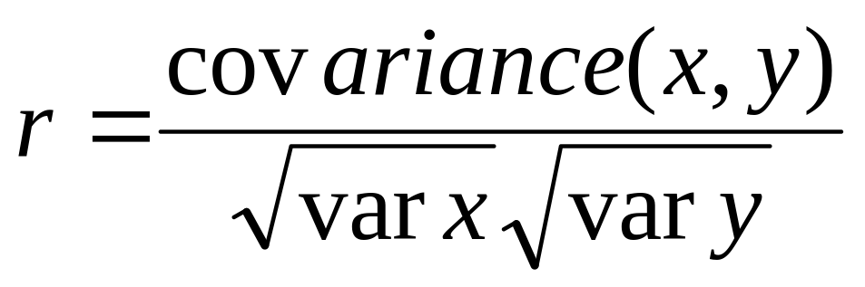
Correlation coefficient
Pearson’s Correlation Coefficient is standardized covariance (unitless):

Slide 5
Correlation
Measures the relative strength of the linear relationship between two variables
Unit-less
Ranges between –1 and 1
The closer to –1, the stronger the negative linear relationship
The closer to 1, the stronger the positive linear relationship
The closer to 0, the weaker any positive linear relationship

Slide 6
Scatter Plots of Data with Various Correlation Coefficients
Y
Y
Y
X
X
X
r = -1
r = -.6
r = 0
Y
Y
Y
X
X
X
r = +1
r = +.3
r = 0
Slide from: Statistics for Managers Using Microsoft® Excel 4th Edition, 2004 Prentice-Hall

Slide 7
Linear Correlation
Linear relationships
Curvilinear relationships
Y
Y
X
X
Y
Y
X
X
Slide from: Statistics for Managers Using Microsoft® Excel 4th Edition, 2004 Prentice-Hall

Slide 8
Linear Correlation
Strong relationships
Weak relationships
Y
Y
X
X
Y
Y
X
X
Slide from: Statistics for Managers Using Microsoft® Excel 4th Edition, 2004 Prentice-Hall

Slide 9
Linear Correlation
No relationship
Y
X
Y
X
Slide from: Statistics for Managers Using Microsoft® Excel 4th Edition, 2004 Prentice-Hall

Slide 10
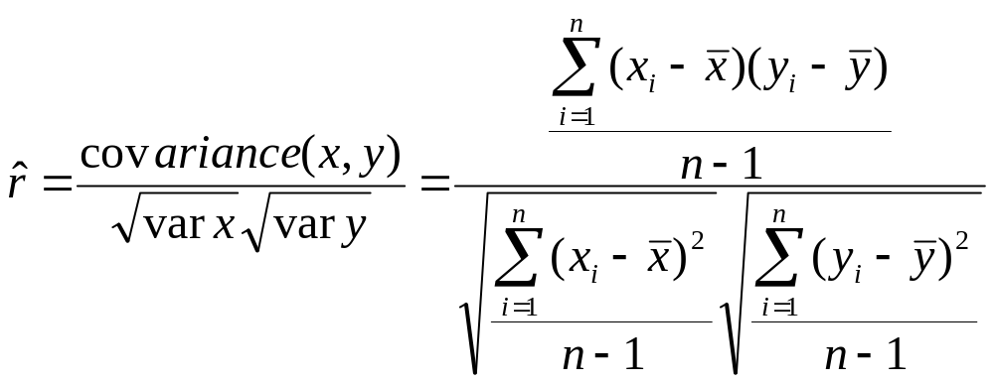
Calculating by hand…

Slide 11
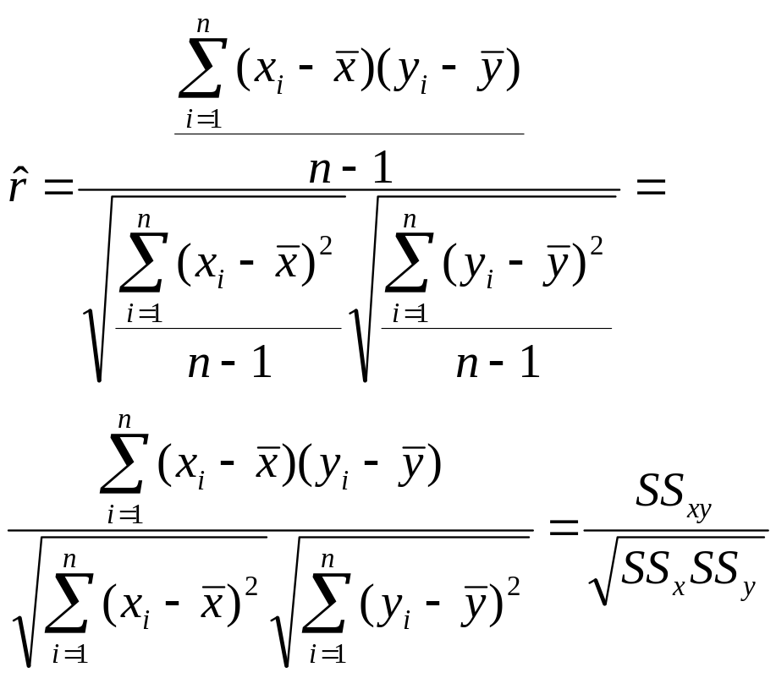
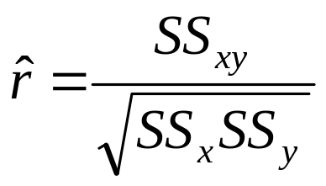
Simpler calculation formula…
Numerator of covariance
Numerators of variance

Slide 12
Linear regression
In correlation, the two variables are treated as equals. In regression, one variable is considered independent (=predictor) variable (X) and the other the dependent (=outcome) variable Y.

Slide 13
What is “Linear”?
Remember this:
Y=mX+B?
m
B

Slide 14
What’s Slope?
A slope of 2 means that every 1-unit change in X yields a 2-unit change in Y.

Slide 15
Predicted value for an individual…
y_{i}= α + β*x_{i} + random error_{i}
Fixed – exactly on the line
Follows a normal distribution
Notes:
For same i or all i

Slide 16
Assumptions (or the fine print)
Linear regression assumes that…
  1. The relationship between X and Y is linear
  2. Y is distributed normally at each value of X
  3. The variance of Y at every value of X is the same (homogeneity of variances)
  4. The observations are independent

Slide 17
The standard error of Y given X is the average variability around the regression line at any given value of X. It is assumed to be equal at all values of X.
S_{y/x}
S_{y/x}
S_{y/x}
S_{y/x}
S_{y/x}
S_{y/x}

Slide 18


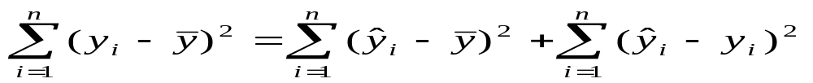
Regression Picture
y_{i}
C
A
B
y
B
A
C
y_{i}
*Least squares estimation gave us the line (β) that minimized C²
x
R²=SS_{reg}/SS_{total}
A² B² C²
SS_{total}
Total squared distance of observations from naïve mean of y
Total variation
SS_{reg}
Distance from regression line to naïve mean of y
Variability due to x (regression)
SS_{residual}
Variance around the regression line
Additional variability not explained by x—what least squares method aims to minimize

Slide 19
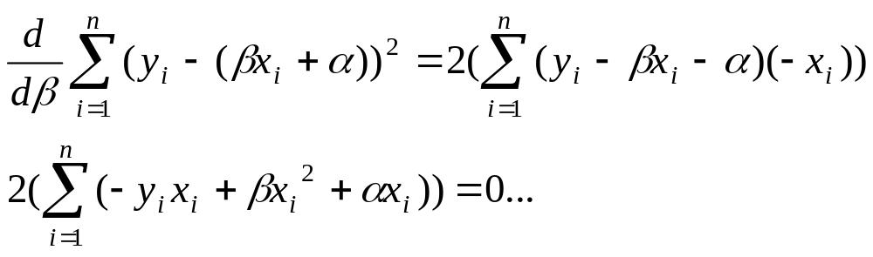
Estimating the intercept and slope: least squares estimation
** Least Squares Estimation
A little calculus….
What are we trying to estimate? β, the slope, from
What’s the constraint? We are trying to minimize the squared distance (hence the “least squares”) between the observations themselves and the predicted values , or (also called the “residuals”, or left-over unexplained variability)
Difference_{i} = y_{i} – (βx + α) Difference_{i}² = (y_{i} – (βx + α)) ²
Find the β that gives the minimum sum of the squared differences. How do you maximize a function? Take the derivative; set it equal to zero; and solve. Typical max/min problem from calculus….
From here takes a little math trickery to solve for β…

Slide 20
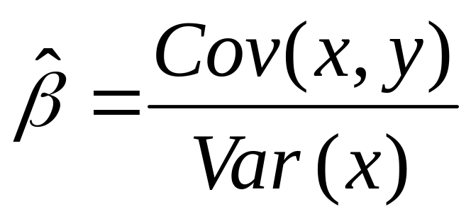
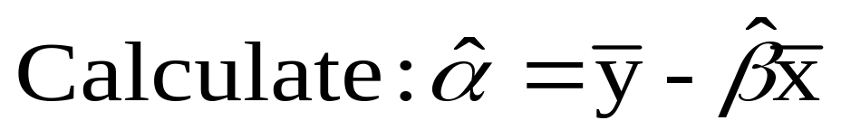
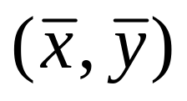
Resulting formulas…
Slope (beta coefficient) =
Intercept=
Regression line always goes through the point:

Slide 21
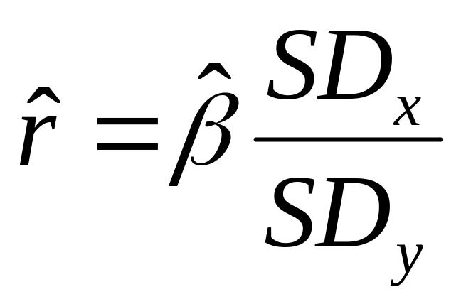
Relationship with correlation
In correlation, the two variables are treated as equals. In regression, one variable is considered independent (=predictor) variable (X) and the other the dependent (=outcome) variable Y.

Slide 22
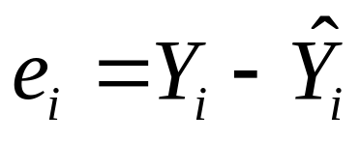
Residual Analysis: check assumptions
The residual for observation i, e_{i}, is the difference between its observed and predicted value
Check the assumptions of regression by examining the residuals
  Examine for linearity assumption
  Examine for constant variance for all levels of X (homoscedasticity)
  Evaluate normal distribution assumption
  Evaluate independence assumption
Graphical Analysis of Residuals
  Can plot residuals vs. X

Slide 23

Residual Analysis for Linearity
Y
Y
x
x
residuals
x
x
residuals
Not Linear
✓
Linear
Slide from: Statistics for Managers Using Microsoft® Excel 4th Edition, 2004 Prentice-Hall

Slide 24

Residual Analysis for
Homoscedasticity
Y
Y
x
x
residuals
x
x
residuals
✓
Non-constant variance
Constant variance
Slide from: Statistics for Managers Using Microsoft® Excel 4th Edition, 2004 Prentice-Hall

Slide 25

Residual Analysis for Independence
Not Independent
✓
Independent
residuals
X
residuals
X
residuals
X
Slide from: Statistics for Managers Using Microsoft® Excel 4th Edition, 2004 Prentice-Hall

Slide 26
Multiple Linear Regression
More than one predictor…
E(y)= α + β₁*X + β₂ *W + β₃ *Z…
Each regression coefficient is the amount of change in the outcome variable that would be expected per one-unit change of the predictor, if all other variables in the model were held constant.

Slide 27
Other types of multivariate regression
Multiple linear regression is for normally distributed outcomes
Logistic regression is for binary outcomes
Cox proportional hazards regression is used when time-to-event is the outcome

Slide 28
Common multivariate regression models.
Outcome (dependent variable) | Example outcome variable | Appropriate multivariate regression model | Example equation | What do the coefficients give you?
Continuous | Blood pressure | Linear regression | blood pressure (mmHg) = α + βsalt*salt consumption (tsp/day) + βage*age (years) + βsmoker*ever smoker (yes=1/no=0) | slopes—tells you how much the outcome variable increases for every 1-unit increase in each predictor.
Binary | High blood pressure (yes/no) | Logistic regression | ln (odds of high blood pressure) = α + βsalt*salt consumption (tsp/day) + βage*age (years) + βsmoker*ever smoker (yes=1/no=0) | odds ratios—tells you how much the odds of the outcome increase for every 1-unit increase in each predictor.
Time-to-event | Time-to- death | Cox regression | ln (rate of death) = α + βsalt*salt consumption (tsp/day) + βage*age (years) + βsmoker*ever smoker (yes=1/no=0) | hazard ratios—tells you how much the rate of the outcome increases for every 1-unit increase in each predictor.

